Slide 1
CSE 583 Technology review: where2charge User Interface
Arsalan Esmaili
Soheil Keshavarz

Slide 2
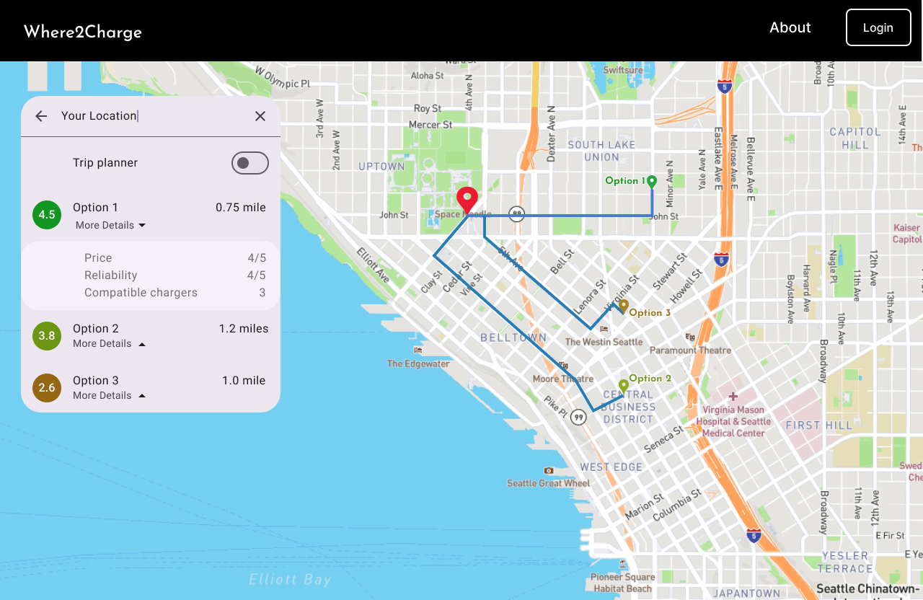
Intro
Goal: develop a charging recommendation tool
Components:
Back end: data analysis and suggesting the best charging stations
Front end: an interactive map where user can get reliable EVCS suggestions and their routes

Slide 3
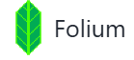

Interactive map
We can use folium
Python’s Folium library gives you access to the mapping strengths of the Leaflet JavaScript library through a Python API.
A popular tool for interactive maps
Well-documented
The map needs to be embedded into a user interface

Slide 4

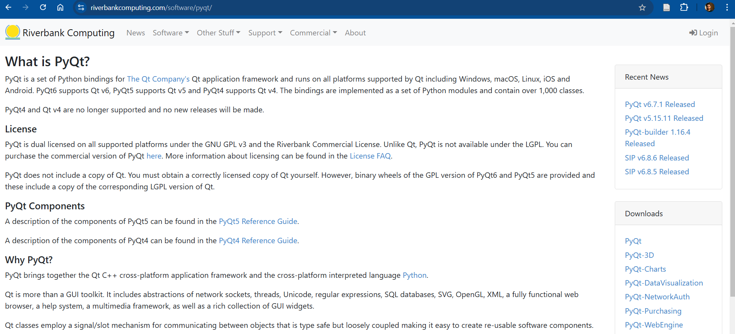
Option 1- PyQt5
PyQt5 is the latest version of a GUI widgets toolkit developed by Riverbank Computing. It is a Python interface for Qt, one of the most powerful, and popular cross-platform GUI library. PyQt5 is a blend of Python programming language and the Qt library.
GitHub: unavailable
Poor UI/documentation design
Not suitable for web app development
Compatible with folium
Notes:
Qt or "cute"
Cross-platform application development framework.
It can bind with many languages and can be written in Python, C++, Java, etc.
It has commercial lisence. So, it is open-source

Slide 5
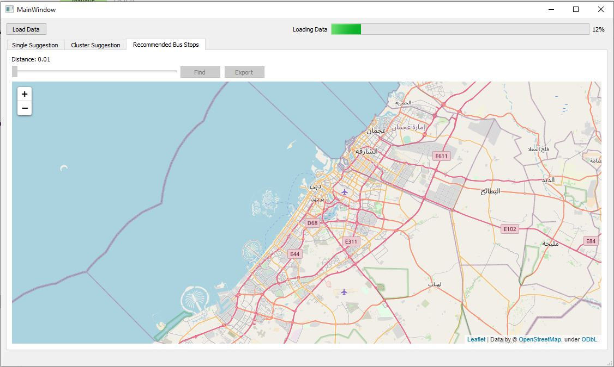

Slide 6

Option 2 - Streamlit
Streamlit is an open-source Python framework for data scientists and AI/ML engineers to deliver interactive data apps – in only a few lines of code.
GitHub credibility: valid and up to date
User-friendly with a vibrant community
Has a complete and robust documentation
Provides interactive platform and maps such as folium can be embedded into it.
Can be deployed online
We have experience working with it

Slide 7
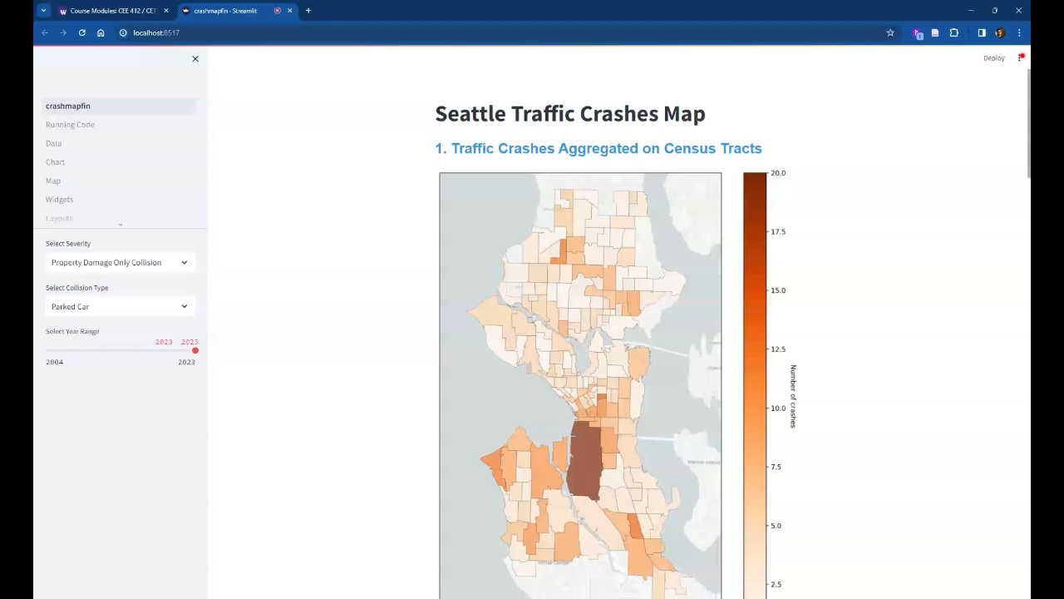

Slide 8

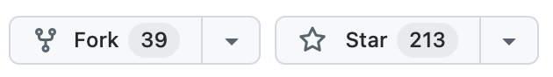
Option 3 – Plotly Dash
Dash is the most downloaded, trusted Python framework for building ML & data science web apps.
Built on top of Plotly.js, React and Flask, Dash ties modern UI elements like dropdowns, sliders, and graphs
directly to your analytical Python code.
Can be used for web apps
Syntax: Need to follow a specific structure.
Cannot be integrated with folium
Dash-leaflet can be used to generate interactive maps

Slide 9
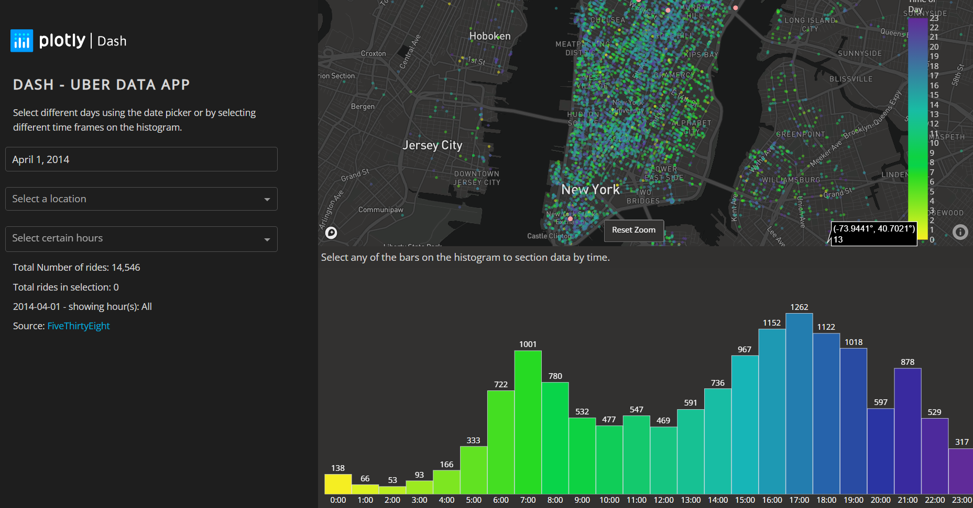

Slide 10
Our choice
Streamlit:
Easier to use. Saves time and help us focus on finishing the project
Bigger community – More tutorials on the Web
Compatibility with folium

Slide 11
Django? Is it something that we have to use in our request handler?
Should we focus on making an app? Or a web app?

